Slide 1

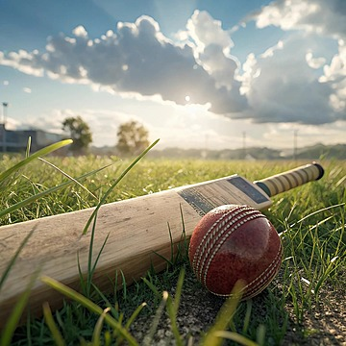
IPL Match Winner Prediction
Anuriya Raveendran
DA-DS

Slide 2
INTRODUCTION
The Indian Premier League (IPL) is one of the most popular T20 cricket tournaments in the world, involving teams with top international and domestic players. Predicting the winner of an IPL match is challenging due to the dynamic nature of the game and various influencing factors like teams, venue, toss, and match conditions.
Objective:
The aim of this project is to predict the winner of an IPL match based on various features such as the teams playing, toss winner, toss decision, and other match-related factors using different machine learning models like Logistic Regression, SVM, KNN, Decision Trees, Random Forest, and XGBoost.
The best model must be selected after evaluating the performance and hyperparameters must be tuned for further improvements..

Slide 3
DATA UNDERSTANDING
id | Season | city | date | team1 | team2 | toss_winner | toss_decision | result | dl_applied | winner | win_by_runs | win_by_wickets | player_of_match | venue | umpire1 | umpire2 | umpire3
1 | IPL-2017 | Hyderabad | 05-04-2017 | Sunrisers Hyderabad | Royal Challengers Bangalore | Royal Challengers Bangalore | field | normal | 0 | Sunrisers Hyderabad | 35 | 0 | Yuvraj Singh | Rajiv Gandhi International Stadium, Uppal | AY Dandekar | NJ Llong
2 | IPL-2017 | Pune | 06-04-2017 | Mumbai Indians | Rising Pune Supergiant | Rising Pune Supergiant | field | normal | 0 | Rising Pune Supergiant | 0 | 7 | SPD Smith | Maharashtra Cricket Association Stadium | A Nand Kishore | S Ravi
3 | IPL-2017 | Rajkot | 07-04-2017 | Gujarat Lions | Kolkata Knight Riders | Kolkata Knight Riders | field | normal | 0 | Kolkata Knight Riders | 0 | 10 | CA Lynn | Saurashtra Cricket Association Stadium | Nitin Menon | CK Nandan
4 | IPL-2017 | Indore | 08-04-2017 | Rising Pune Supergiant | Kings XI Punjab | Kings XI Punjab | field | normal | 0 | Kings XI Punjab | 0 | 6 | GJ Maxwell | Holkar Cricket Stadium | AK Chaudhary | C Shamshuddin

Slide 4
WORKFLOW
Model Evaluation
Modeling process
Data cleaning & EDA

Slide 5
Data cleaning
🧹 Steps Taken to Clean the Data:
🔹 Removed irrelevant columns (like match ID, umpire names, etc.)
🔹 filled the rows of missing value with imputation(mode) method & Dropped rows with missing values that couldn’t be filled meaningfully.
🔄 Handling Categorical Features:
🔹 Applied Label Encoding to convert text columns into numbers
(e.g., 'team1', 'team2', 'venue', 'winner’)
📊 Feature Scaling:
🔹 Standardized numerical features like win_by_runs and win_by_wickets using StandardScaler to ensure consistent data scale

Slide 6
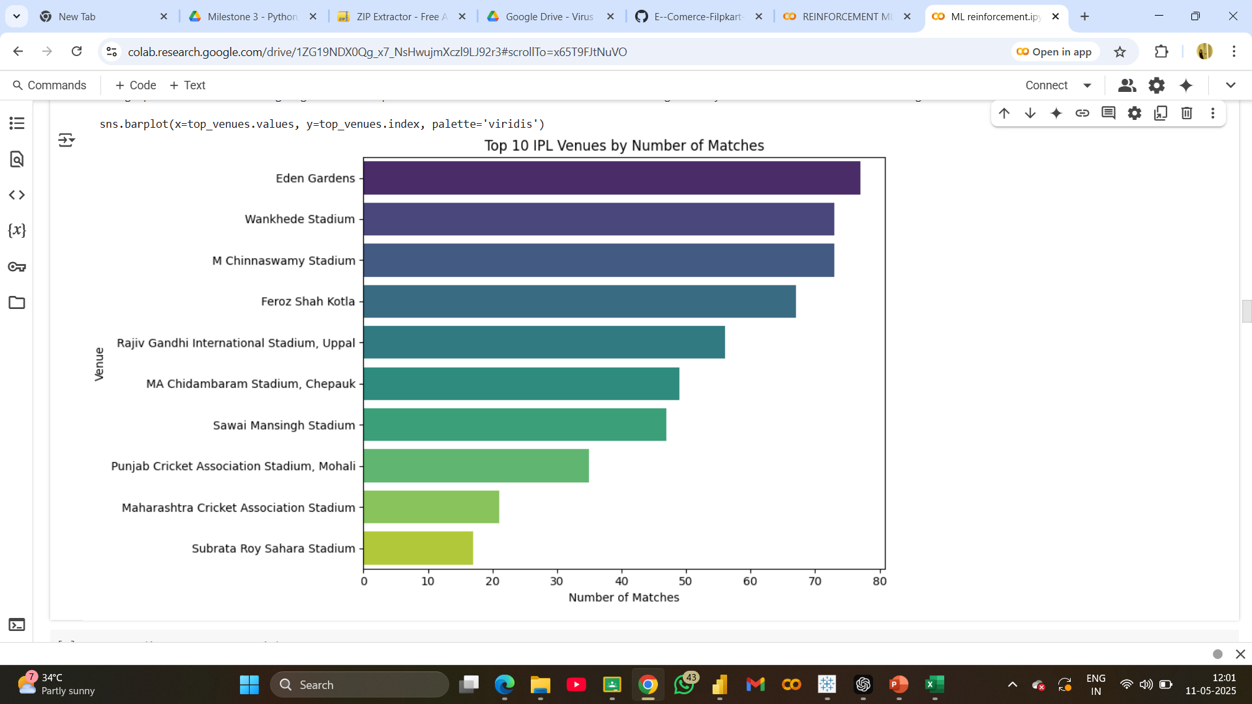
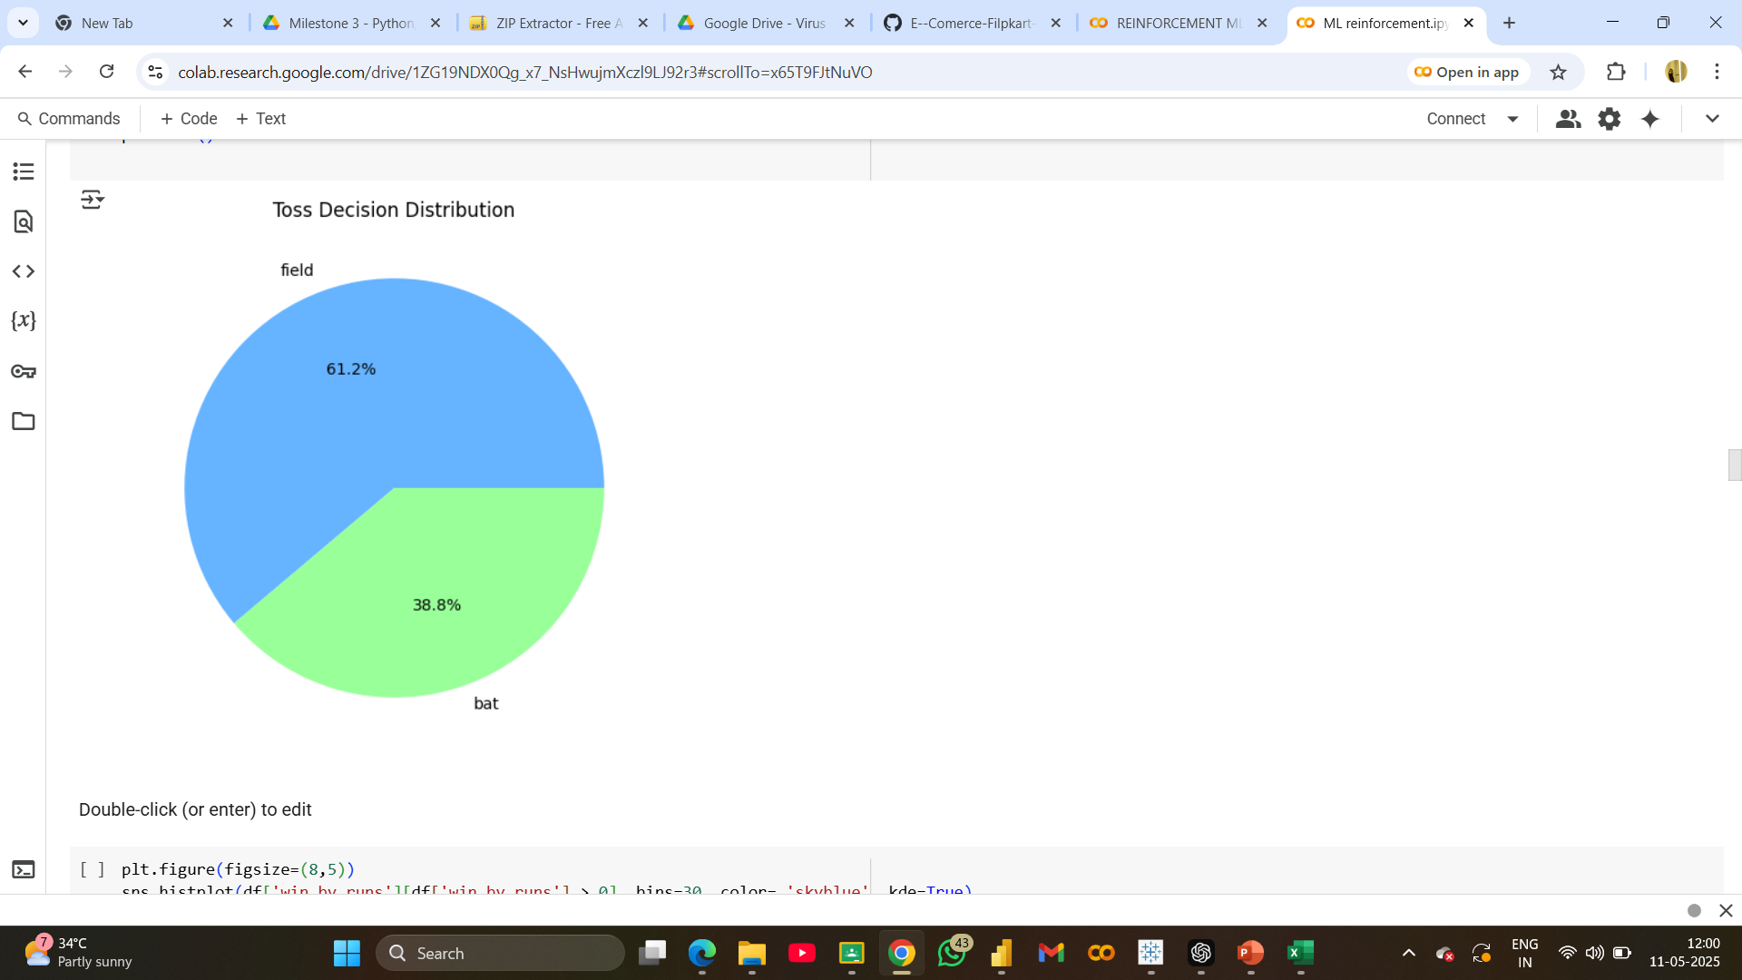
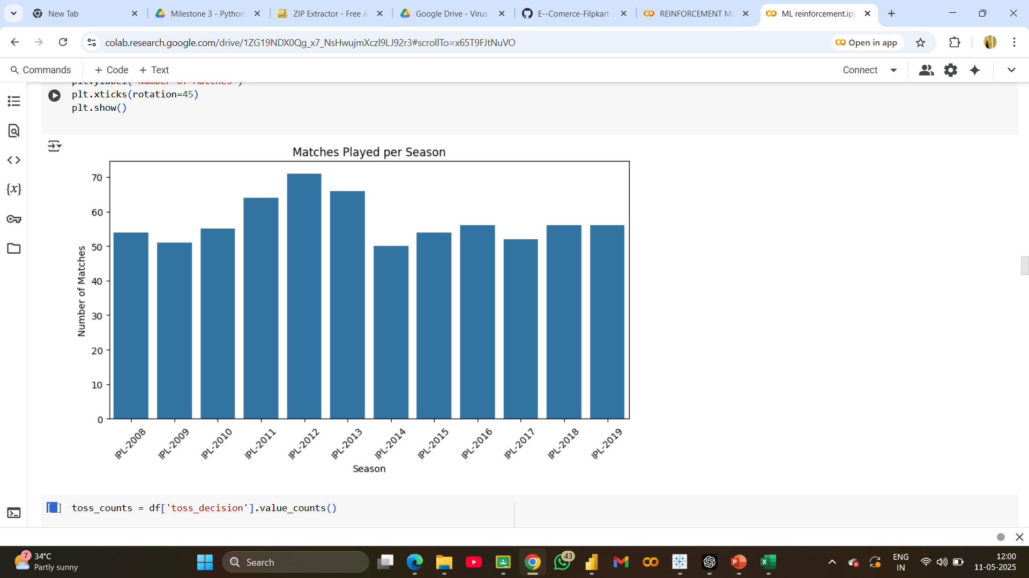
Exploratory Data Analysis (EDA):

Slide 7
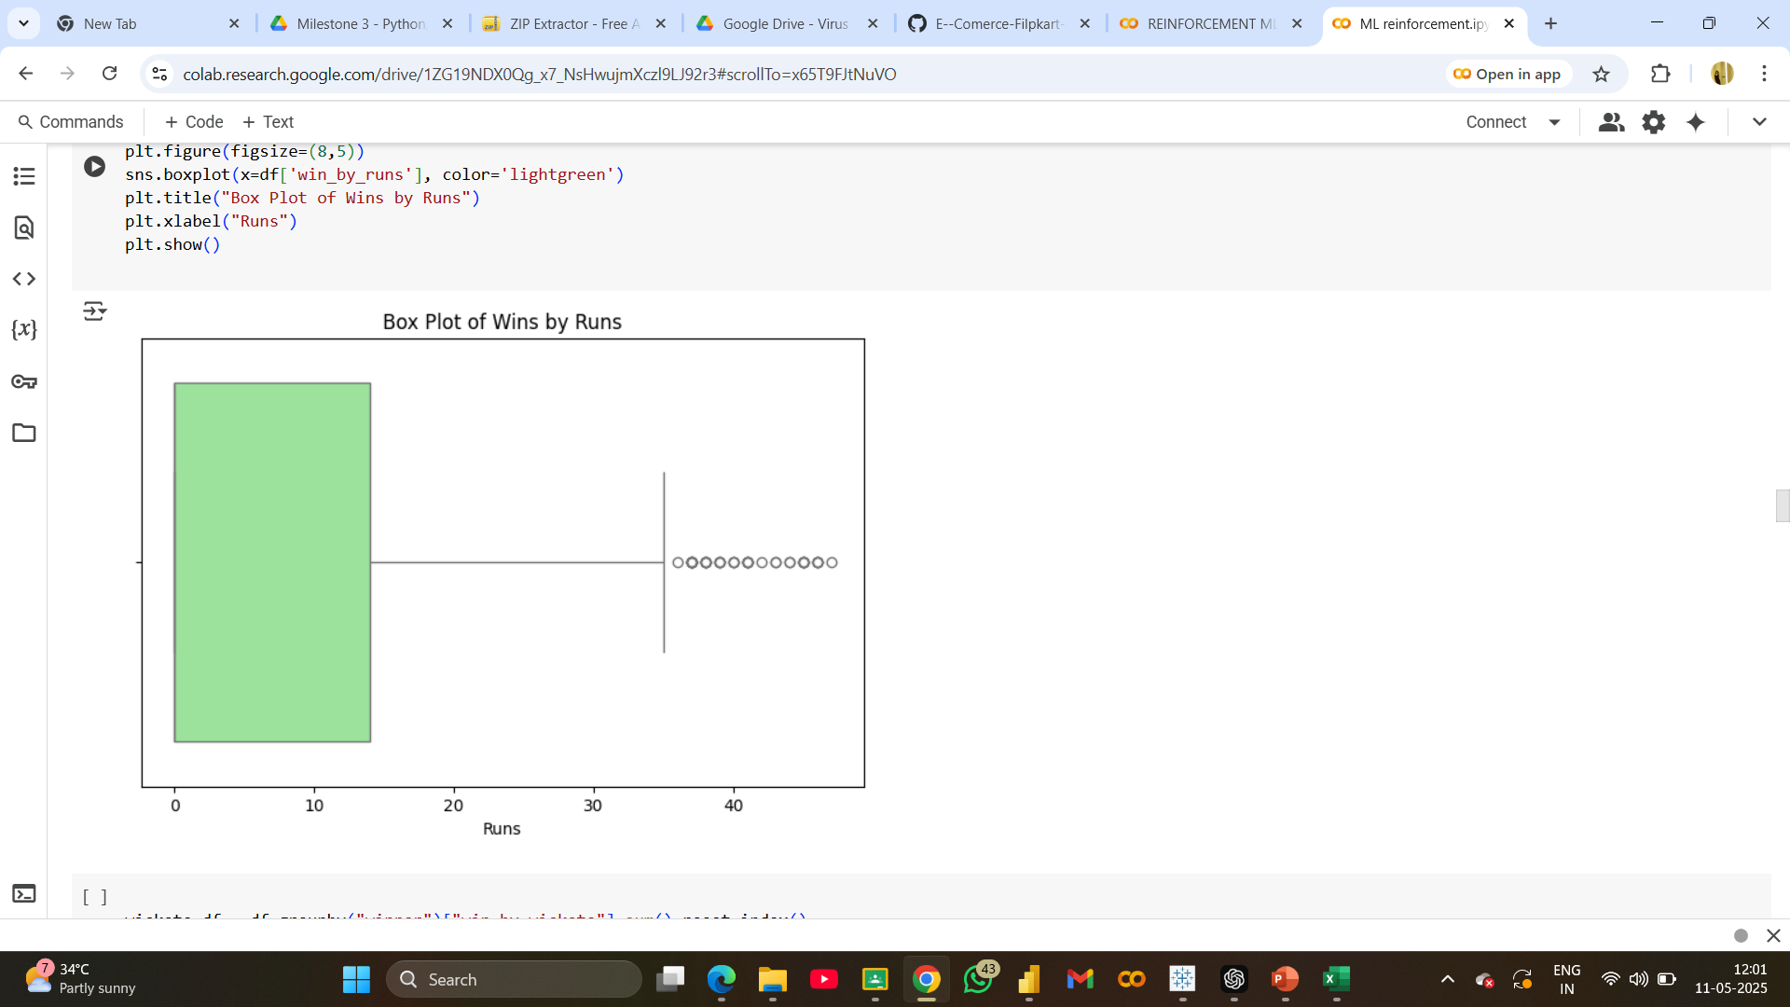
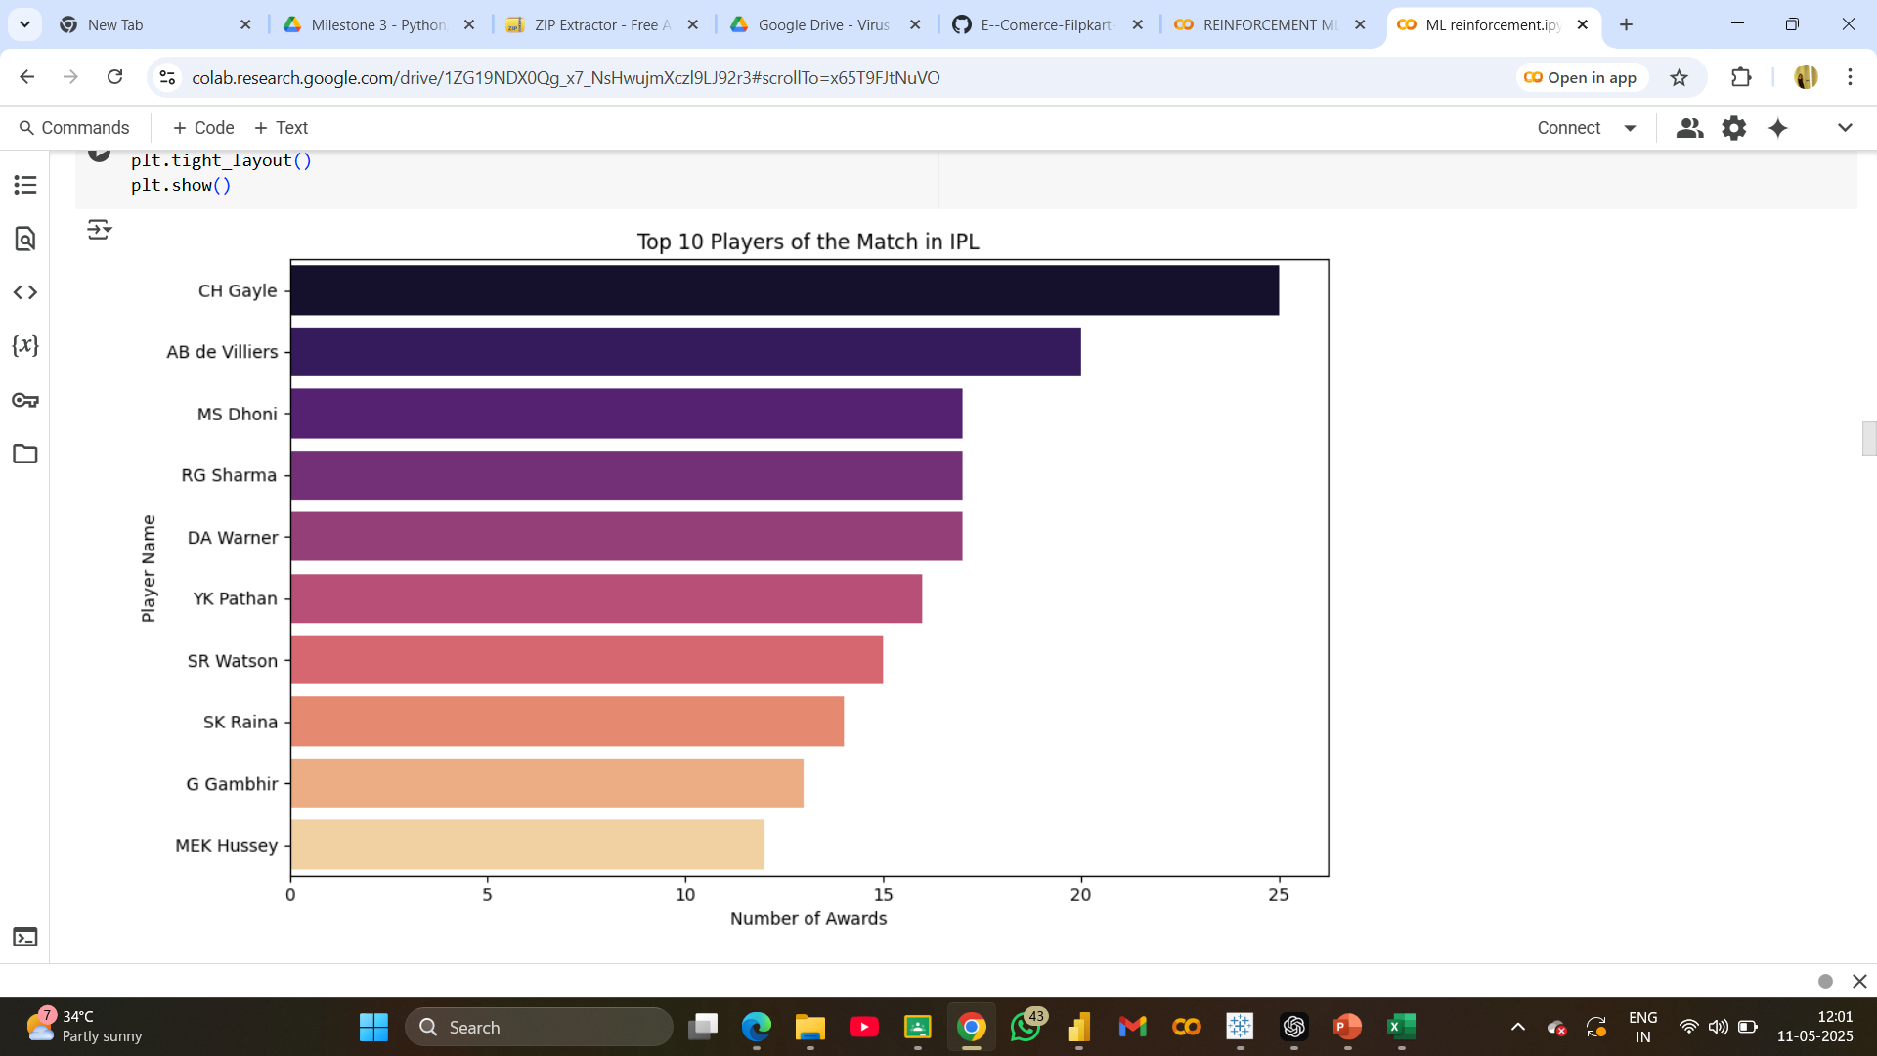
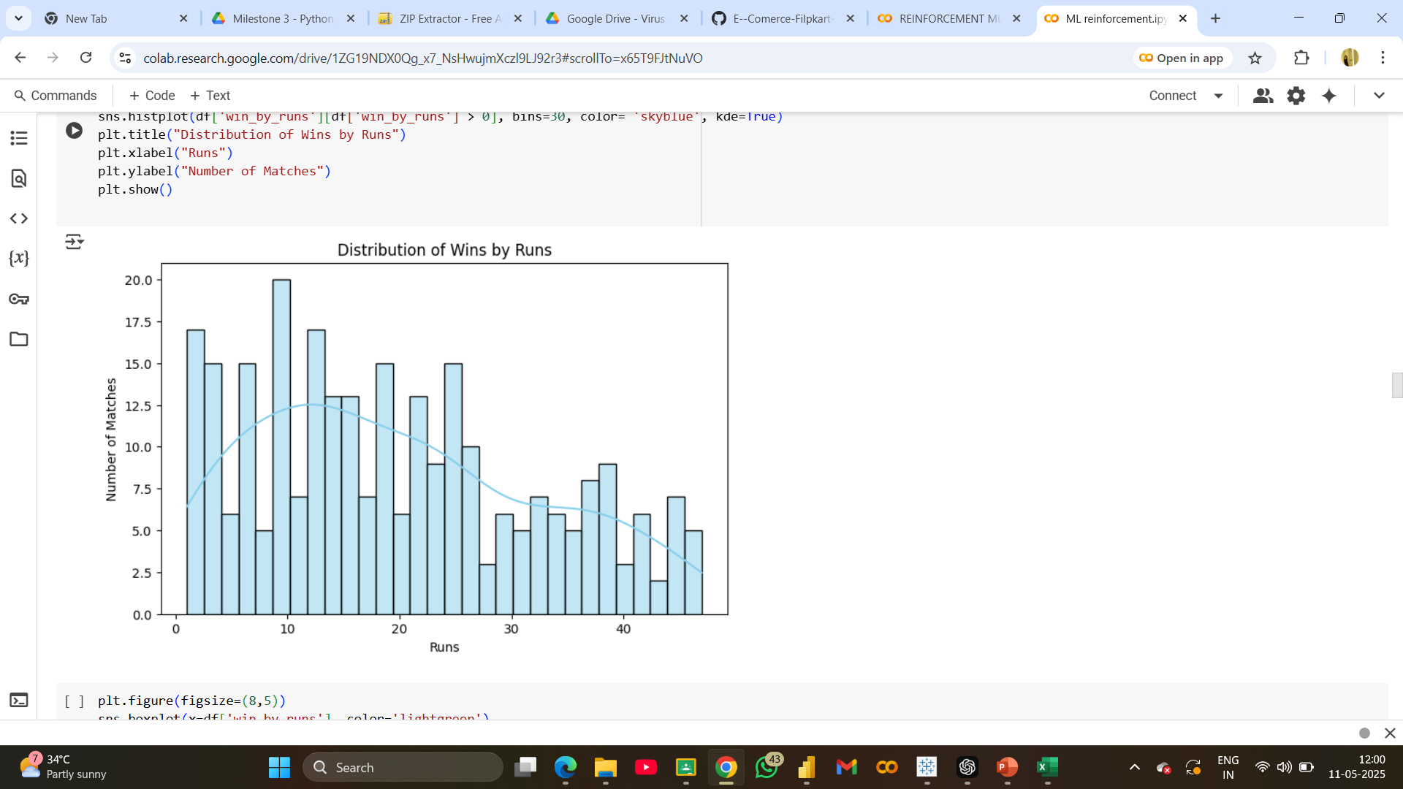

Slide 8
Modelling process
🧠 Models Used:
🔹 Logistic Regression
🔹 Support Vector Machine (SVM)
🔹 K-Nearest Neighbors (KNN)
⚙️ Hyperparameter Tuning:
✅ Grid Search was used to find the best parameters
✅ Tuned the best-performing model (XGBoost) for optimal results
📏 Evaluation Metrics:
🔹 Accuracy – Overall correctness
🔹 Precision – Correctness of positive predictions
🔹 Recall – Model's ability to detect positives
🔹 F1-Score – Balance between precision & recall
🔹 Decision Tree
🔹 Random Forest
🔹 XGBoost

Slide 9
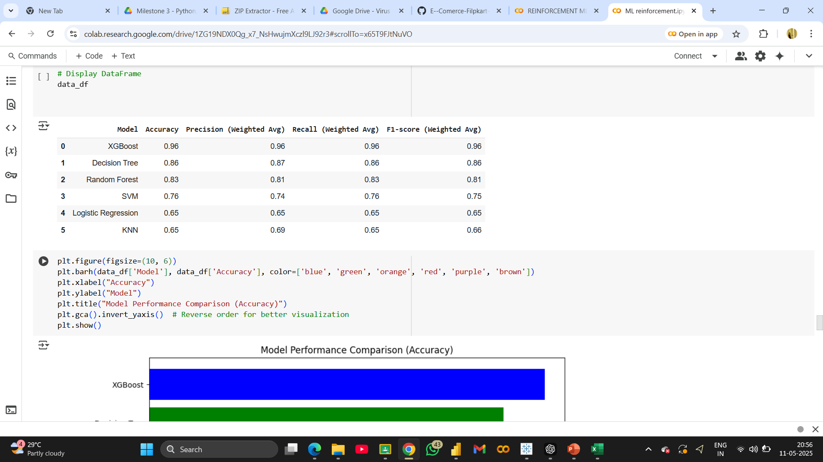
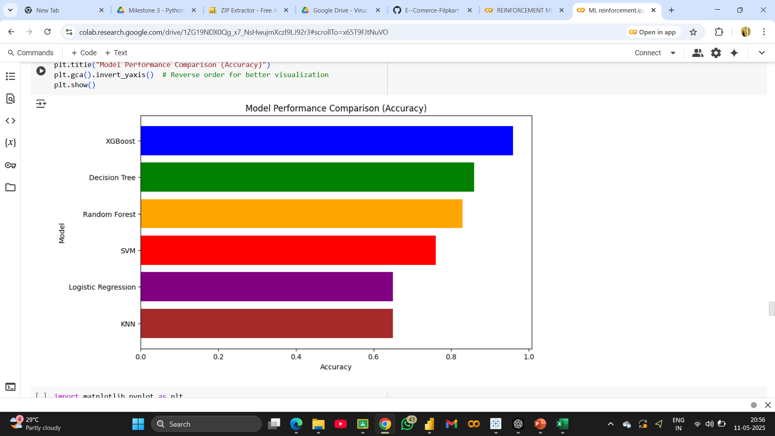
Model Comparison

Slide 10
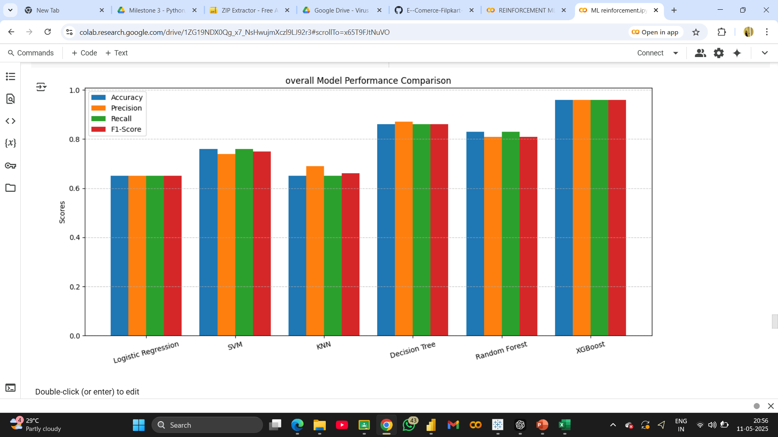

Slide 11
conclusion
✅ Project Summary:
Built a machine learning model to predict IPL match winners
Explored and compared six models: Logistic Regression, SVM, KNN, Decision Tree, Random Forest, and XGBoost
XGBoost (Tuned) gave the best results with 97% accuracy
🚀 Key Learnings:
Data preprocessing and feature encoding are critical for model performance
Model tuning using Grid Search significantly boosts accuracy
Evaluation metrics like precision, recall, and F1-score give a deeper understanding than accuracy alone
🔮 Way Forward:
Add more contextual features (e.g., player stats, match location effects)
Automate data collection from live sources
Build a user-friendly prediction interface (web/app)

Slide 12
Thankyou !

